Slide 1
Image Classifier Engine Webservice
User Manual

Slide 2
Downloads and Preparations:
Docker Desktop Application
To use the product, you will have to download Docker Desktop app, you can do so in the following link:
https://docs.docker.com/desktop/windows/install/
Open the application and activate the engine, then finish the tutorial in the Docker app after installing. And the app will be ready for usage.

Slide 3
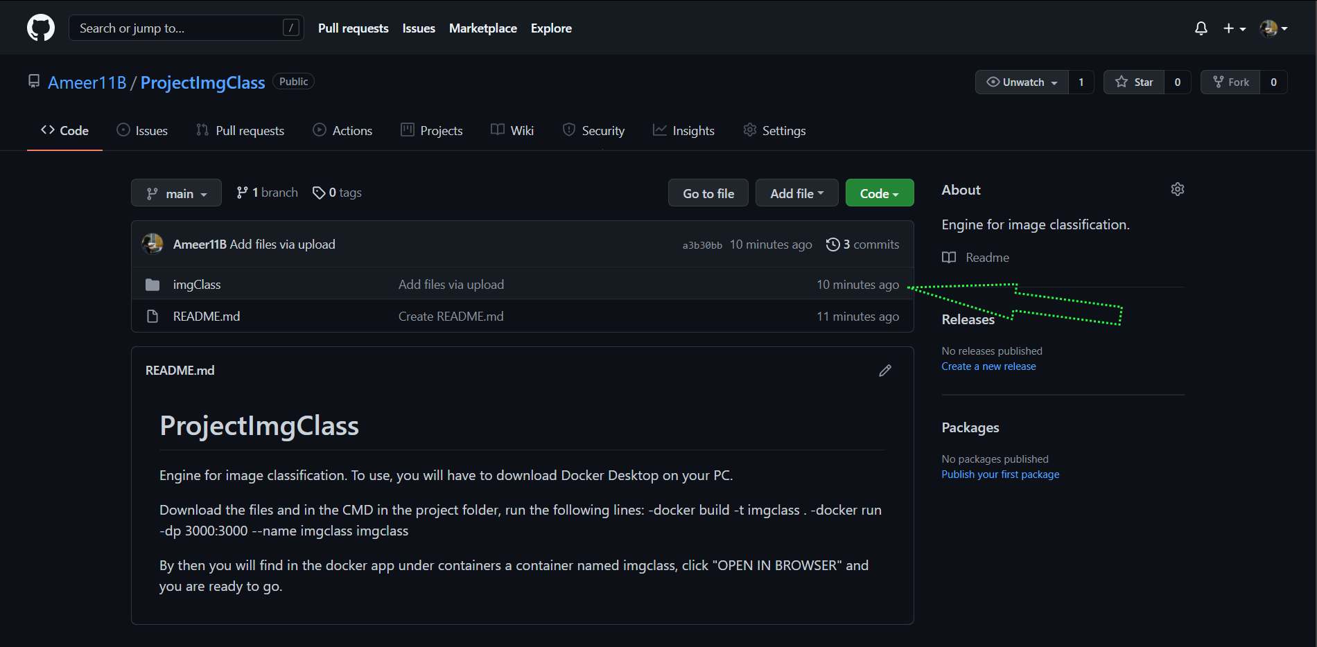
Now that you have the Docker app, its time to download the folder that contains the code that will become later the webservice you want to use.
Visit the following link first:
https://github.com/Ameer11B/ProjectImgClass
Now download the folder imgClass that appears in the files in the project.

Slide 4
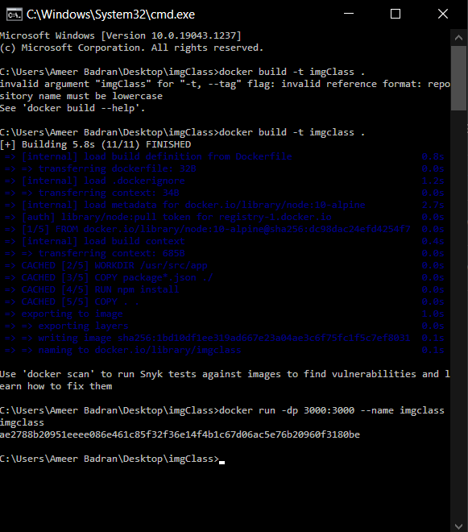
Now enter your cmd and get to the imgClass directory, then run the following commands:
docker build -t imgclass .
docker run -dp 3000:3000 –-name imgclass imgclass
by the end your cmd should look like this:

Slide 5
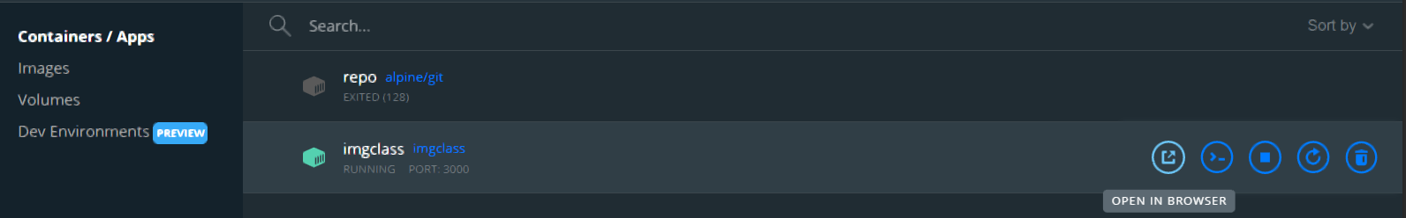
Then on your Docker app, under containers you should get the imgclass container, which will be available to run, click the “OPEN IN BROWSER” option to open the webservice.

Slide 6
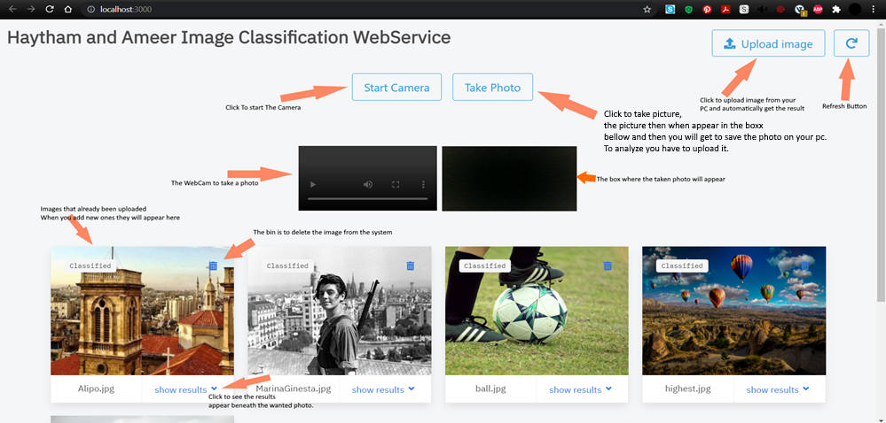
Using the Webservice

Slide 7
It is important to state that the service except only image files of type jpg or png, and the name of the file should be only English letters. This way no problems should happen at all.
And that’s it.
Follow the steps carefully and one step at a time, and you will find the service running on any PC in any circumstances.

